Slide 1
Introduction to Python for Matlab Users
Brian Anderson, MS

Slide 2
General background
Why is python ‘better’?
What does python code look like
Accepting Inputs
Lists
Strings
0 indexing and range()
For and While loops
Dictionaries
Making Modules Loadable
How to install python
Basic Dicom / Advanced Dicom
Python in deep learning (how to install tensorflow and tensorflow-gpu)
Classes
Confusing things in python

Slide 3
How to install python
I highly recommend downloading Python as a standalone (not Anaconda), but this is personal preference: https://www.python.org/downloads/release/python-373/ (get the x64 version at the bottom)
Get PyCharm, it is free since you are students: https://www.jetbrains.com/

Slide 4
Pip install Jupyter notebooks
After python is installed, you can add to it by opening a command prompt and typing ‘pip install package’

Slide 5
Download a package from github
If you are going to use python, you should familiarize yourself with github
For windows users, download the program git https://git-scm.com/downloads
Download the rest of this tutorial by navigating to a folder in your local drive (or anywhere) and typing
git clone https://github.com/brianmanderson/Teaching-Python-to-Matlab-Users.git

Slide 6

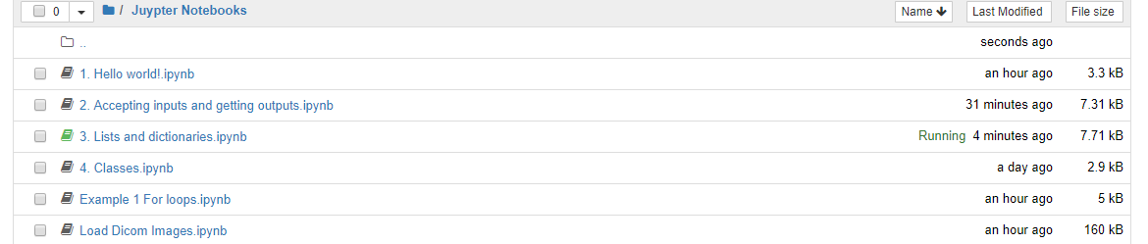
Run juptyer notebook
Then navigate to where downloaded the tutorial with ‘cd’ (change directory)
cd ..\Teaching Python to Matlab Users
And type jupyter notebook

Slide 7
Hello world!
The slides after this are for reference means only, otherwise we will stick to the files in the jupyter notebook

Slide 8
Why is python ‘better’?
Python runs very ‘lean’, in that only a few tools are available to you unless you specifically import others
This means it can be very fast, and created .exe files can be relatively small
IT’S FREE!

Slide 9
Quick Reminder
Anything with a black background is in python
Anything with a white background is in Matlab
In general the Matlab code will be on the left column and Python on the right

Slide 10


What does it look like?
Notice that in python, the words beneath the def are tabbed, while those
In matlab are not. This is because Matlab uses ‘end’, while python relies on
The spacing to determine where everything is

Slide 11





Accepting inputs
Note the difference in how the string is added in python. Here, the ‘+’ sign concatenates strings together

Slide 12
New things in Python
Lists! Imagine matlab arrays which can accept (almost) anything
This list has a string, an integer, and an array
Lists are self-defined… that means, using a for-loop will iterate over each thing in the list. Example on next slide

Slide 13
For loops with lists
This part might seem confusing at first

Slide 14

For loops with lists
This part might seem confusing at first

Slide 15
For loops with lists
This part might seem confusing at first

Slide 16

For loops with lists
This part might seem confusing at first

Slide 17
Exercise 1
Colors = [‘Blue’,’Red’,’Green’,’White’]
Write a for loop which prints off each color in the Colors list

Slide 18
Exercise 1
Colors = [‘Blue’,’Red’,’Green’,’White’]
Write a for loop which prints off each color in the Colors list
for x in Colors:
print(x)
The only thing that matters is that whatever you put as x is also x in print()

Slide 19
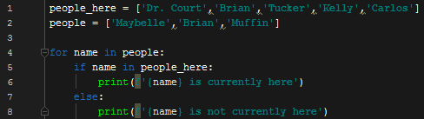


Identifying things in lists
Python has rather unique ways of identifying items
I want to determine if all of the people are in people_here
This is False since all of people is not contained within people_here
However, ‘Brian’ IS within people here

Slide 20
Identifying things in lists
Now lets say I want to find out exactly which index Brian is in people_here, similar to find(…) in matlab
This really gets into the ‘object oriented’ part of Python

Slide 21
Identifying things in lists
In matlab you’d do something similar to find(people_here, ‘Brian’)
In Python, these functions are a part of the variables themselves
Why did it return 1?

Slide 22
Identifying things in lists
In matlab you’d do something similar to find(people_here, ‘Brian’)
In Python, these functions are a part of the variables themselves
Why did it return 1?
Because 0 indexing!

Slide 23

Identifying things in string
Similarly, if you have a long string, such as:
And want to find where Muffin starts, the function is intrinsically part of the string itself

Slide 24

For loops with lists
For loops and lists

Slide 25
For loops and while loops
What if you don’t want to iterate over the items in a list, but instead want to repeat a function a number of times?
In matlab you would define the range as (start, step, stop)

Slide 26
For, if, and while loops
Python holds numbers in a function called ‘range’
The syntax is range(start,stop,steps)
So, range(0,5,1) will go to 4
It WILL NOT go to 5
Any idea why it won’t go to 5?

Slide 27
For, if, and while loops
Python holds numbers in a function called ‘range’
The syntax is range(start,start,steps)
So, range(0,5,1) will go to 4
It WILL NOT go to 5
Any idea why it won’t go to 5?
Because python starts at the 0 index, not 1 like Matlab
Next slide explains a little more

Slide 28

0 indexing
Imagine you have a list of 5 items
The length of the list is 5
So, as x increases the following will print
X = 0, print ‘1’
X = 1, print ‘2’
X = 2, print ‘3’
X = 3, print ‘4’
X = 4, print ‘5’
If X went to 5, it would be out of the range of the list

Slide 29
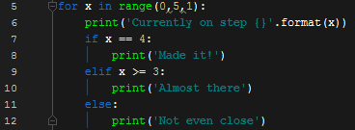
For and while loop

Slide 30
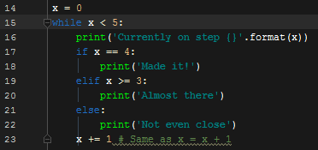
For and while loop

Slide 31
Exercise 2
Write a for loop which prints the even numbers from 0 to 10 (including 10)

Slide 32
Exercise 2
Write a for loop which prints the even numbers from 0 to 10 (including 10)
For x in range(0,12,2):
Print(x)
Note that I have 12 listed as the stopping point, not 10

Slide 33
Dictionaries
Dictionaries are arguably the coolest thing in Python (in my opinion)
Imagine a set of keys, like explained in Dennis’ previous presentation, with any number of values to be set

Slide 34


Dictionaries
You can make dictionaries a few different ways
Here we first define the dictionary as what is within the key ‘Key’
Now, we have two keys:
You can look at the data in each key like this:

Slide 35
Dictionaries
You can put anything in a dictionary
For example, say you have 100 images, you can make a dictionary with keys [‘Image x’] from x to 100 each with a corresponding image
And, you could put a dictionary of those images within a dictionary of patients

Slide 36

Dictionary within Dictionary

Slide 37
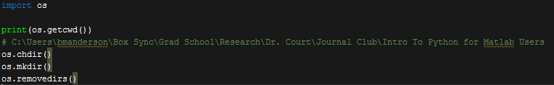
Importing modules
Python is ‘lean’, if you need to use something, you’ll likely have to import a module for it
For example, to change directory you will need the ‘os’ module

Slide 38
Writing functions
Recall:

Slide 39

Returning Outputs

Slide 40
Returning Outputs

Slide 41
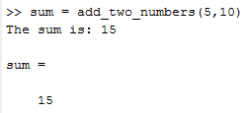
Returning Outputs

Slide 42
Pause
Try to write the function in python, have it print the answer
Don’t forget, spacing is important!!

Slide 43
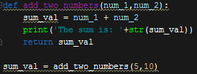
Returning Outputs

Slide 44
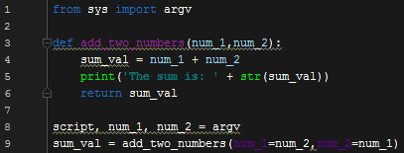
Returning Outputs, with argv

Slide 45
Returning Outputs, with argv

Slide 46
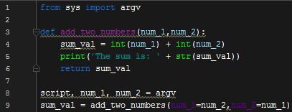
Returning Outputs, with argv

Slide 47
Returning Outputs
Lets say I have a new function, and it involves adding two numbers together…
I don’t want to have to re-write my module ‘add_two_numbers’
I’ll need to import it, this means I need to change my code up a little

Slide 48
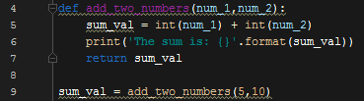
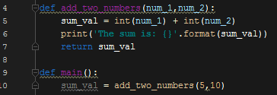
Making modules loadable
This function is saved as ‘add_two_numbers.py’
Some issues with this: No matter what, when I run the function it will give me back a sum_val. I want to make it such that I can import the def add_two_numbers without anything else

Slide 49
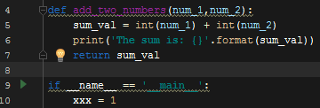
Making modules loadable
This is saying, that if you run this python code nothing is going to happen, just xxx = 1

Slide 50
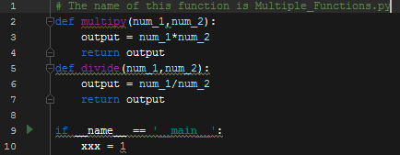
Making modules loadable
This is where we really start to get into the ‘object-oriented’ nature of python
For kicks, I’ll make one more module called Multiple_Functions.py

Slide 51
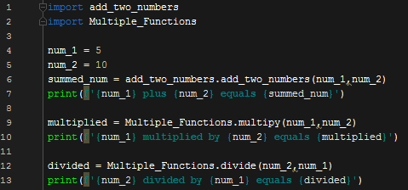

Loading modules

Slide 52
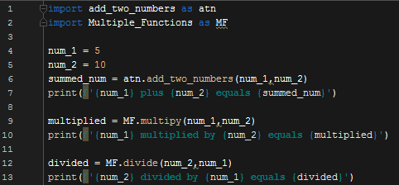
Loading modules
The whole add_two_numbers.add_two_numbers is kind of awkward..
Import the module as something different

Slide 53
Exercise
Write a module which subtracts two numbers
Then, write a new module which loads in that module and subtracts 20 from 10

Slide 54
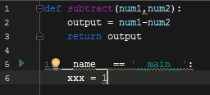


Exercise

Slide 55
Python deep learning
To run them you’ll need Microsoft Visual Studios C++ packages
Install python 3.6.2 x64 (MAKE SURE YOU GET THIS RIGHT)
Install windows visual studio (modify to include C++)
Install CUDA toolkit 8.0 https://developer.nvidia.com/cuda-80-ga2-download-archive
Add to path:
C:\Program Files\NVIDIA GPU Computing Toolkit\CUDA\v8.0\bin;
C:\Program Files (x86)\NVIDIA Corporation\PhysX\Common;
C:\Program Files\NVIDIA GPU Computing Toolkit\CUDA\v8.0\libnvvp;
C:\Program Files\NVIDIA GPU Computing Toolkit\CUDA\v8.0\bin;
Download cuDNNv6.0 https://developer.nvidia.com/rdp/cudnn-download (You must make an account, etc.)
Extract ^ to somewhere. Add to path
Y:\cuda; Y:\cuda\bin; (Or wherever you put it)
Make sure you can open ‘python’ from cmd. If you can’t, ensure you have these in path
C:\Users\bmanderson\AppData\Local\Programs\Python\Python36\Scripts\;
C:\Users\bmanderson\AppData\Local\Programs\Python\Python36\;
Install pycharm
In Pycharm open settings -> Project -> Project Interpreter -> Select Python at top. -> click ‘+’ sign, search for tensorflow-gpu -> install

Slide 56
Classes
A class is a way of making a framework for similar things, or tasks
Say you want to make something that describes students here at MDA
You want to know have their name, grad school, major, and maybe undergrad

Slide 57
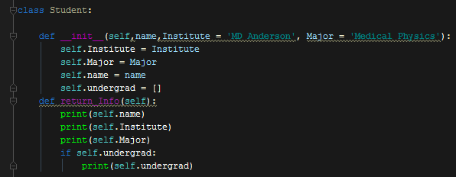
Classes
Not everyone here is getting their degree from this institution though, but we can make the default MDA
So, when making a class you start off by defining the __init__

Slide 58
Classes
Now, add something to return the info…
Note that def return_Info only has self as an input

Slide 59

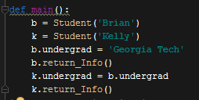
Classes
So you can make multiple students

Slide 60
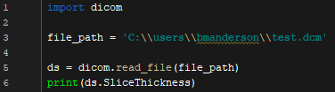
Basic Dicom
Load a single dicom file as variable ds

Slide 61
More advanced Dicom
class Dicom_Creator(object): def __init__(self,files_path): self.files_path = files_path def get_files(self): fileList = [] self.lstFilesDCM = [] self.lstRSFile = [] self.Dicom_Data = [] for dirName, dirs, fileList in os.walk(self.files_path): break for filename in fileList: try: ds = dicom.read_file(os.path.join(dirName,filename)) if ds.Modality != 'RTSTRUCT': # check whether the file's DICOM self.lstFilesDCM.append(os.path.join(dirName, filename)) self.Dicom_Data.append(ds) elif ds.Modality == 'RTSTRUCT': self.lstRSFile = os.path.join(dirName, filename) except: continue
This creates a class called Dicom_Creator
It is initialized by a path to the files
Get_files() will create a list of dicom files and all of the dicom data

Slide 62
More advanced Dicom
def get_images_and_mask(self): self.image_size_1 = self.Dicom_Data[0].pixel_array.shape[0] self.image_size_2 = self.Dicom_Data[0].pixel_array.shape[1] self.ArrayDicom = np.zeros([self.image_size_1, self.image_size_2, len(self.lstFilesDCM)], dtype='float32') # loop through all the DICOM files self.slice_locations = [] for filenameDCM in self.lstFilesDCM: # read the file self.ds = self.Dicom_Data[self.lstFilesDCM.index(filenameDCM)] # store the raw image data im = self.ds.pixel_array self.ArrayDicom[:, :, self.lstFilesDCM.index(filenameDCM)] = im # Get slice locations slice_location = round(self.ds.ImagePositionPatient[2],2) self.slice_locations.append(slice_location) RescaleIntercept = self.ds.RescaleIntercept RescaleSlope = self.ds.RescaleSlope self.ArrayDicom = (self.ArrayDicom+RescaleIntercept)/RescaleSlope indexes = [i[0] for i in sorted(enumerate(self.slice_locations), key=lambda x: x[1])] self.ArrayDicom = self.ArrayDicom[:, :, indexes] self.slice_locations.sort()

Slide 63
More advanced Dicom
First line sets a path
Second line initializes our class
Third tells it to run the get_files()
Fourth tells it to get the images
Last pulls the images out for us
path = 'C:\\users\\bmanderson\\dicom_test\\' Dicom_reader = Dicom_Creator(path) Dicom_reader.get_files() Dicom_reader.get_images_and_mask()
Images = Dicom_reader.ArrayDicom

Slide 64
Thank you!
Any questions for what I have here, please feel free to reach out to me at: bmanderson@mdanderson.org
Cheers!

